Slide 1

Amrutvahini College of Engineering, Sangamner
Implementing Deep Neural Network Based Encoder-Decoder Framework for Image Captioning
Team members:
Mr. Mayur Gadakh (4136)
Mr. Gaurav Chaudhari (4116)
Ms. Akanksha Gaikwad (4141)
Ms. Shivanjali Dhage (4126)
Guide: Mr. R. S. Gaikwad

Slide 2
Review III

Slide 3
Requirement analysis:
Functional Requirements:
Image Input: The system must allow users to provide images as input for caption generation.
Caption Generation: The system should generate natural language captions for the provided images using EfficientNetV2 and GRU-based models.
Training Module: The system should have a module for training the caption generation model.
Inference Module: The system should provide an inference module for generating captions in real-time using a trained model.
User Interface: The system should have a user-friendly interface for users to interact with and provide input images and display the generated captions.

Slide 4
Requirement analysis:
Non - Functional Requirements:
Performance: The system should generate captions within a reasonable time frame, with low latency during real-time inference.
Scalability: The system should be designed to handle a growing dataset and user base.
Accuracy: The system should aim for high accuracy in caption generation, as measured by evaluation metrics.
Model Efficiency: The system should use efficient model architectures to ensure that it can run on common hardware and devices.
User Experience: The user interface should be intuitive, providing a positive user experience.

Slide 5
Requirement analysis:
System configurations:
Internal Interface Requirements:
Software Requirements:
Operating System: Windows, macOS, and Linux.
GPU: Dedicated GPU is required
RAM: 8GB (16GB recommended)
Software Frameworks/libraries: Python Tensorflow, Keras.
Hardware requirements:
Hardware: The system should be optimized for standard computer hardware, and it should be adaptable for GPU acceleration if available.
External Interface Requirements:
Data Sources: The system will interface with external datasets, including Flickr8k, Flickr30k, and MSCOCO, for training and evaluation

Slide 6
Questionnaire
Is information domain analysis complete, consistent and accurate?
Is problem statement categorized in identified area and targeted towards specific area there in?
Is external and internal interfacing properly defined?
Are requirement consistent with schedule, resources and budget?
Are all requirements traceable to system level?
What is needed to make the product?
Is there a demand for the produce?
Is identification of stakeholders is done properly?
Whether all requirements are captured and documented inline with scope?
Whether all type of analysis classes are identified or not?
Whether the Acceptance criteria is decided are not?

Slide 7
Review IV

Slide 8
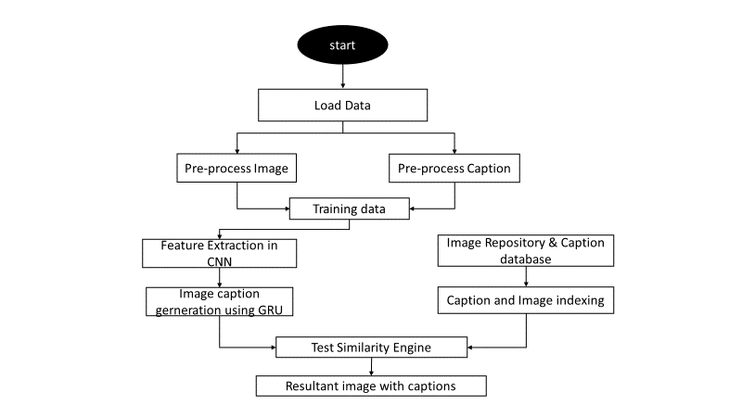
Architecture Diagram:

Slide 9
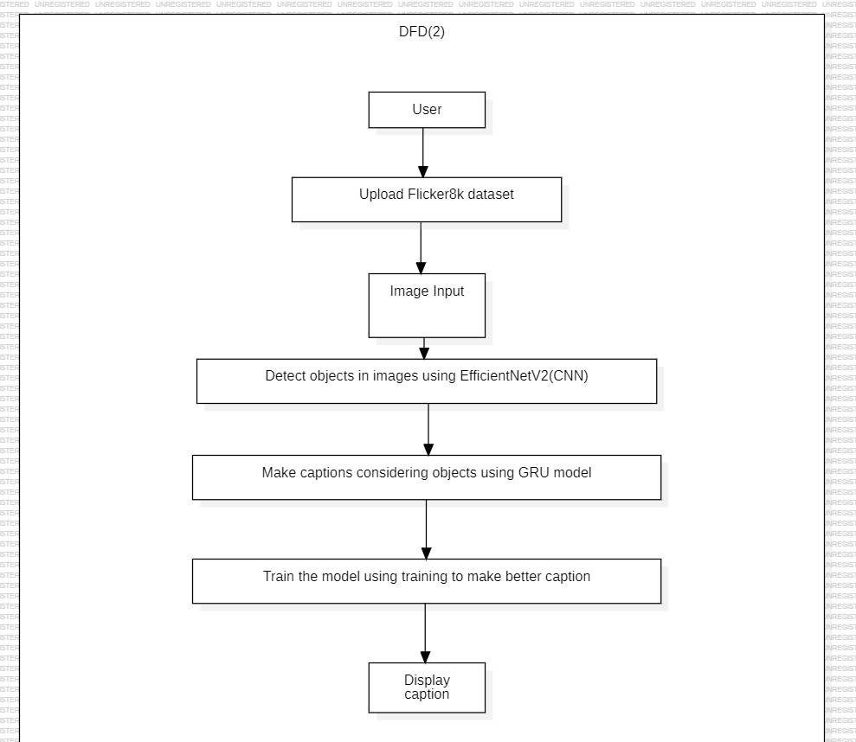
Data Flow Diagram:

Slide 10
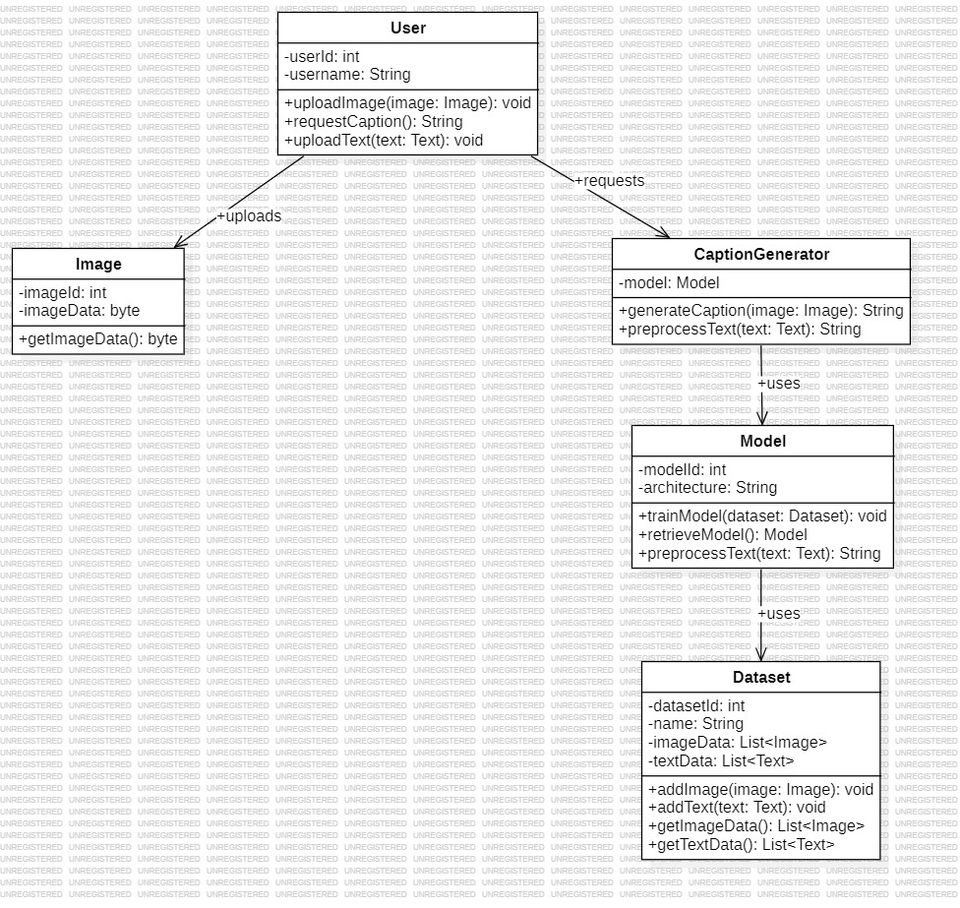
Class Diagram:

Slide 11
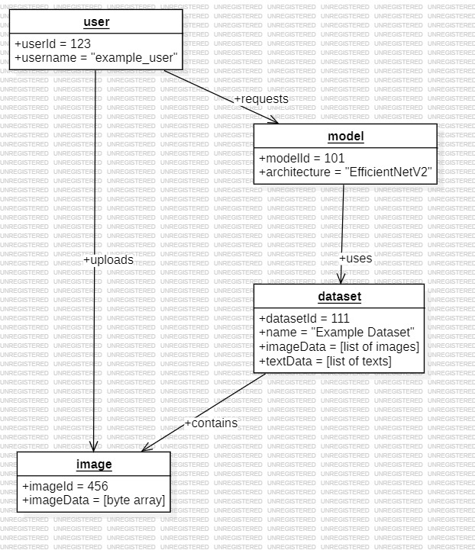
Object Diagram:

Slide 12
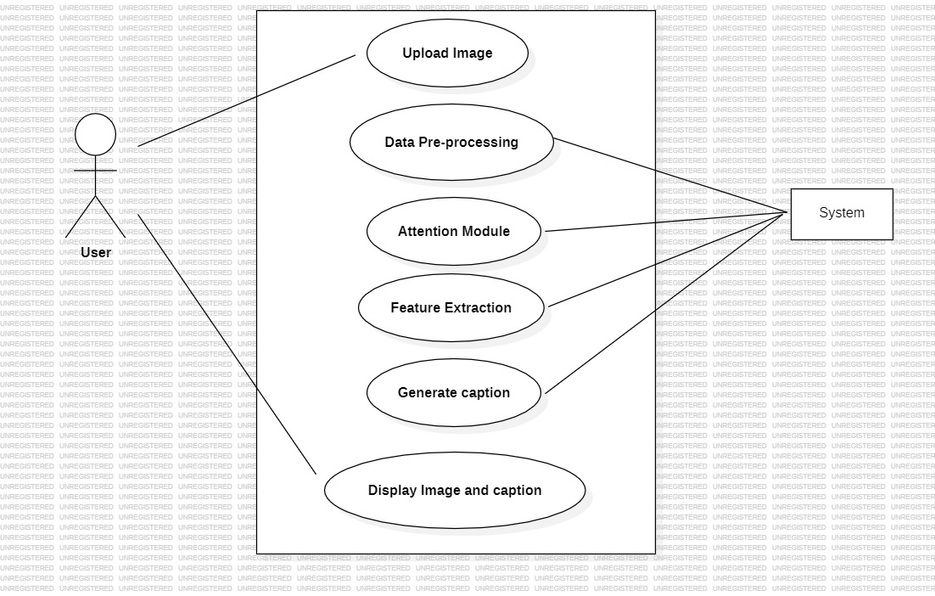
Use Case Diagram:

Slide 13
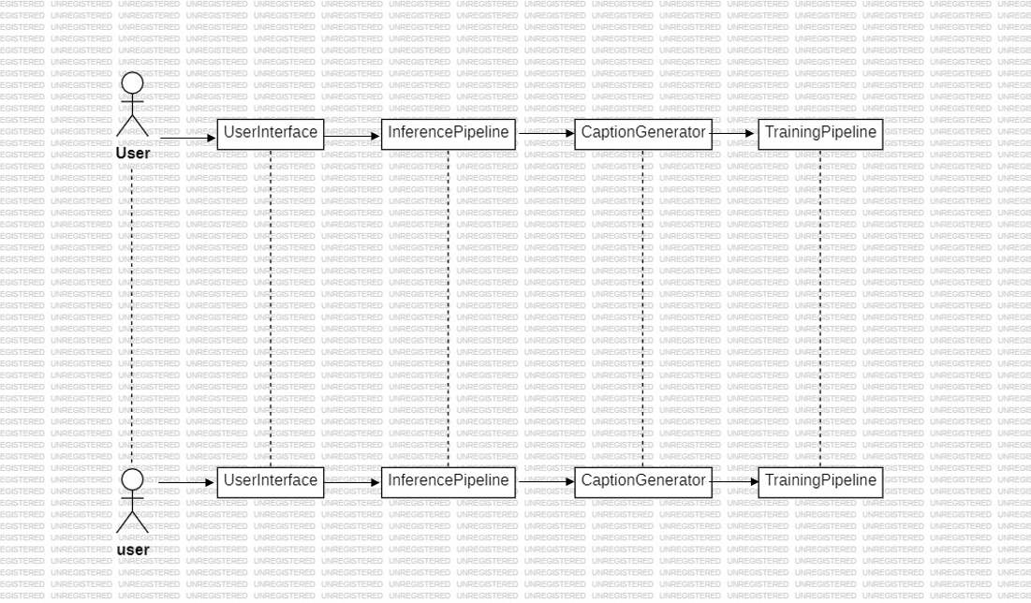
Sequence Diagram:

Slide 14
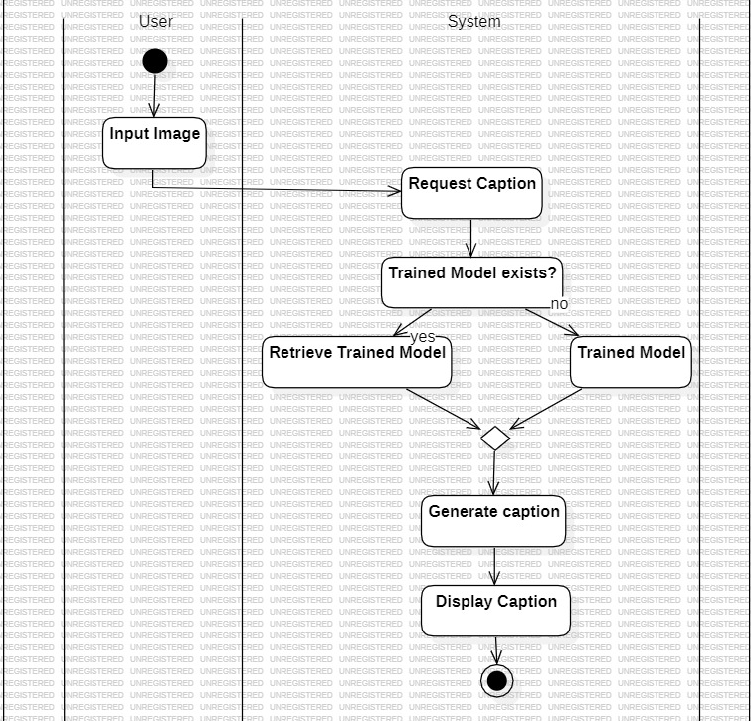
Activity Diagram:

Slide 15
Questionnaire
Are requirement reflected in the system architecture?
Does the design support both project (product) and project goals?
Does the design address all the issues form the requirement?
Is effective modularity achieved and modules are functionally independent?
Are structural diagrams (class, Object, etc) are well defined?
Are all class associations clearly defined and understood? (Is it cleat which classes provide which services)?
Are the classes in the class diagram clear? (What they represent in the architecture design document?)
Is inheritance appropriately used?
Are the multiplicities in the use case diagram depicted in the class diagram?
Are all objects used in sequence diagram?
Are the symbols used in all diagrams corresponding to UML standards?

Slide 16
Are behavioural diagrams (use case, sequence, activity, etc.) well defined and understood ? Does each case have clearly defined actors and input/output?
Does the sequence diagram matches with class diagram?
Is aggregation/ containment (used) clearly defined and understood ? Whether State charts are capturing system's dynamic behaviour correctly or not?
Related to procedural thinking whether DFDS and CFDs along with transaction and transformation flow are done correctly or not?

Slide 17
THANK YOU!

